Slide 1
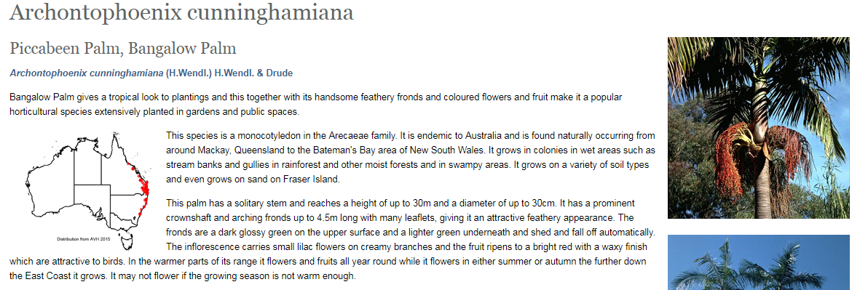
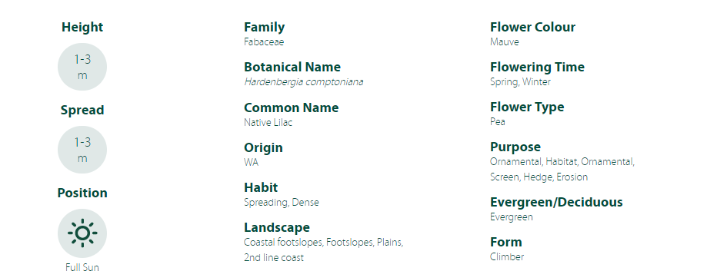
Manual Data collection
Species came from industry/other modules of WPW
Species: 410
Traits per species (mean): 45
Data points: 29831
Example Website: Australian Botanic Gardens Factsheet
Web Scraping Data collection
Species included if they have a clear, binary taxonomic match with global taxonomic databases
Species: 3287 (new)
Traits per species (mean): 17
Data points: 104774
Example Website: Plant Selector Plus (SA Botanic Gardens)

Slide 2
Black: Traits used to select plants
Total: 47 traits
Blue: Descriptive traits – may or may not be used
Red: Consult with stakeholders how to best use these traits
Trait | Frequency | Trait | Frequency | Trait | Frequency
common_name | 7173 | multistem_development | 247 | bark_appearance | 563
light_level | 8134 | foliage_colour | 1589 | bark_texture | 930
frost_tolerance | 3889 | characteristic_feature | 2124 | supp_watering | 3176
drought_tolerance | 2047 | fruit_colour | 406 | invasive_roots | 279
coastal_tolerance | 832 | fruit_period | 161 | root_depth | 135
soil_type | 7080 | seasonal_colour | 186 | waterlogging_tolerance | 331
soil_pH | 5199 | juvenile_traits | 263 | soilcompaction_tolerance | 97
form | 4749 | salinity_tolerance | 577 | soil_volume | 88
growth_rate | 2520 | wind_tolerance | 1161 | soil_fertility | 804
longevity | 1732 | establishment_care | 528 | max_height_nature | 220
leaf_loss | 3540 | ideal_conditions | 1500 | max_height | 2525
flower_colour | 6294 | habit_canopy | 2956 | height | 2240
flower_period | 6477 |  |  | min_height | 2455
placement | 4324 |  |  | max_width | 2351
usage | 7688 |  |  | width | 2168
ecological_services | 1476 |  |  | min_width | 2331
weed_status | 1792
risk | 466

Slide 3
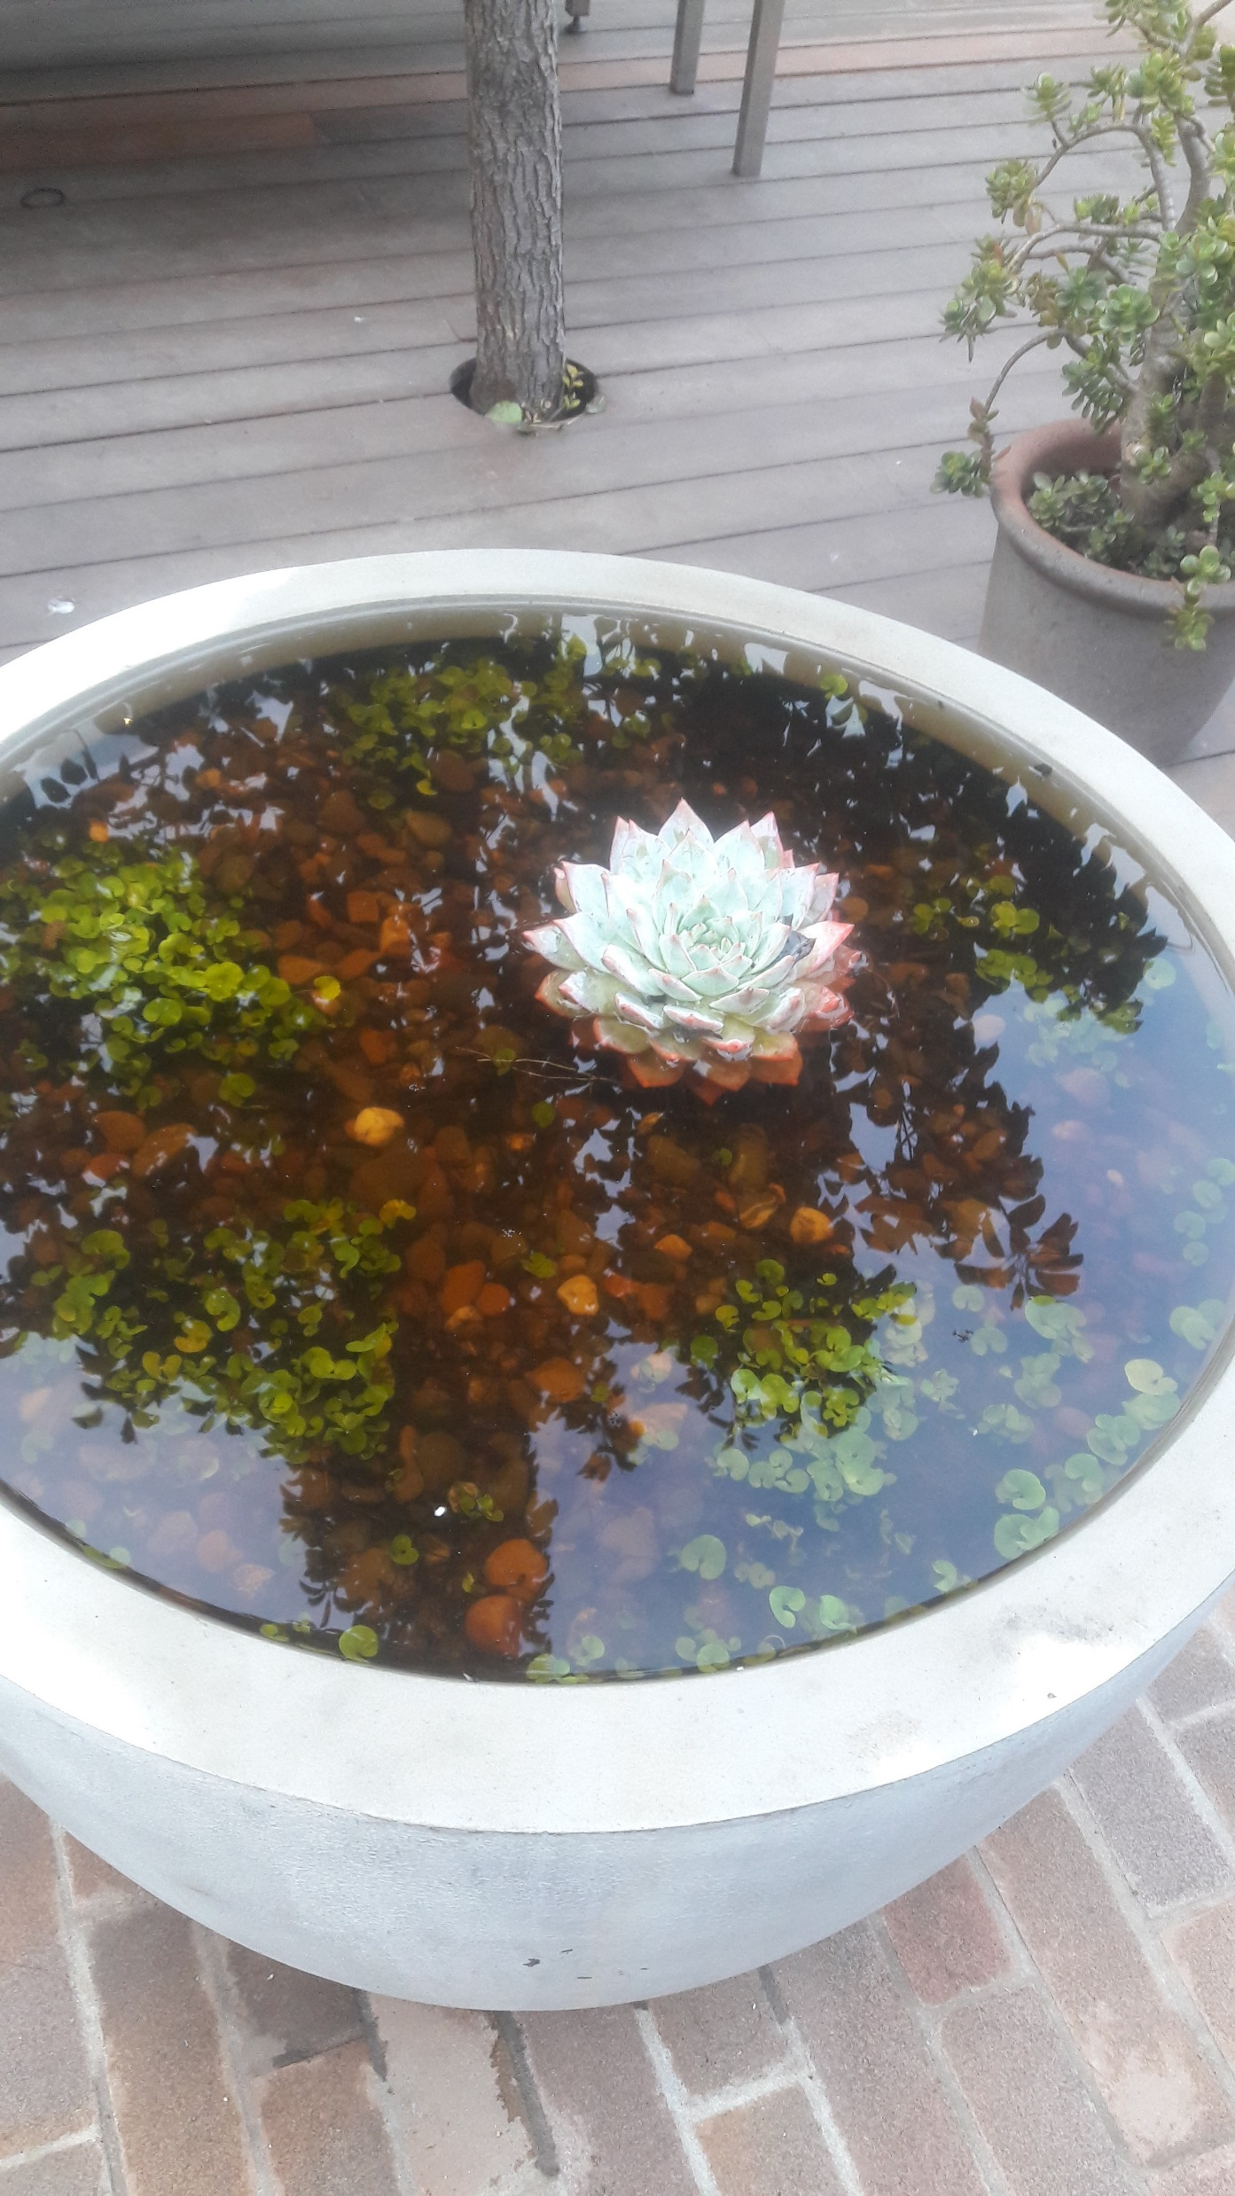
Future directions
We have to find a way to deal with conflicting data
The database is always hungry for more data, particularly Australian species/environment focussed

